Slide 1
Welcome Maternal Infant Health Program (MIHP) Providers!
May 1, 2022

Slide 2
Topics
How do I request a participation packet?
How are qualified members notified about MIHP services?
How do Molina members find a contracted MIHP Provider?
How do I receive referrals for Molina members?
How do I bill Molina Healthcare?
What is required for Prior Authorization?
Who do I contact if I have questions?

Slide 3
How do I participate with Molina Healthcare?
Request a participation packet:
Submit an online contract request form available at: www.molinahealthcare.com/providers/mi/Medicaid/home. Go to Join our Network sections and click contract request form. Complete and submit as prompted.
Once submitted, your request will be sent to a queue for contracting department to review. Once reviewed, a contracting packet will be sent out for you to complete and return.
Once returned, packet is reviewed to ensure all documents have been fully completed, and a contract will be sent out for electronic signature.

Slide 4
Participation Onboarding Questions
I already have a signed Coordination Agreement with Molina.
Do I need to complete another one?
A. One will be included in the contracting packet and it is helpful if you complete it along with the other contracting packet documents.
Q. How long does the contracting/credentialing process take?
If a complete and correct packet is provided, the contracting and credentialing process will take approximately 6-8 weeks. The process starts once your complete packet is received and has been submitted for processing.

Slide 5
Participation Onboarding Questions
Q. How will I know when the contracting and credentialing is complete?
A welcome letter will be sent 30 – 45 days of the date the contract is executed. Credentialing takes 6-8 weeks, and once credentialed a notice will be sent from our credentialing department.
Q. Can I still see Molina members during the credentialing process?
A. Yes, when your contract is submitted for processing and group is submitted for credentialing, you will receive a notification from the contracting department. As a courtesy to our provides a provisional date is assigned which will allow you to see members and bill for services while the contract and credentialing are in process.

Slide 6
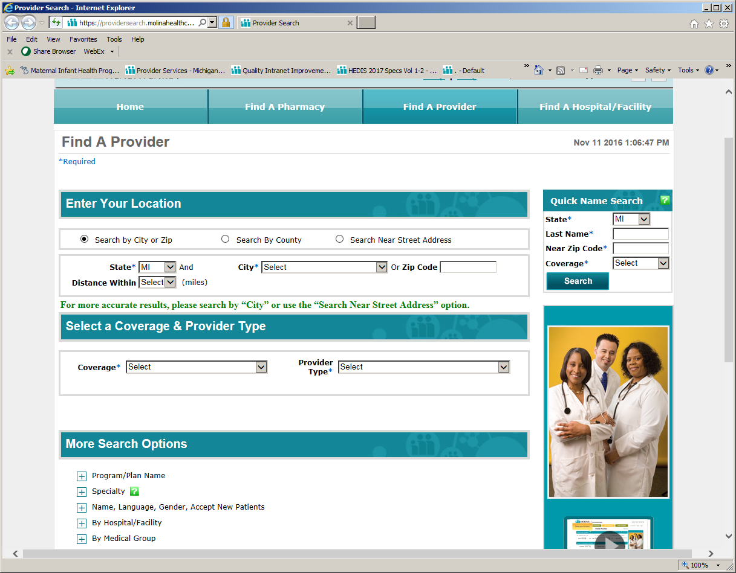
Molina Provider Directory
Contracted MIHPs are listed in Molina’s printed and Online Provider Directory.

Slide 7
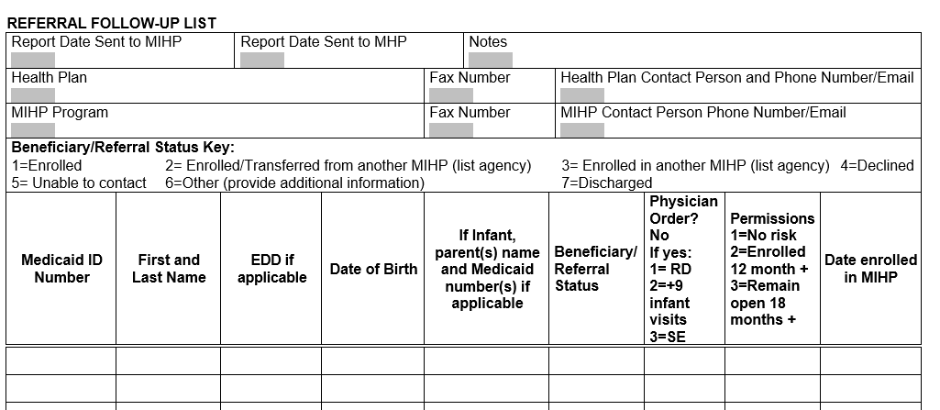
How do I receive referrals for Molina members?
Molina will fax or email * the referrals to contracted MIHP providers each month based on number of new pregnancies.
MIHP to provide the status of each client referred, using the “Date of MIHP Enrollment” column, within 30 days of the referral.
Add additional enrolled clients to the collaboration form.
Send the MIHP-MHP Collaboration Form to:
Fax: (844) 861-1932
MolinaMIHP@molinahealthcare.com
For questions, please contact Brooke Sebok at (947) 622-2987 or by email.
* We do not submit member information to public domain email addresses, i.e. Yahoo, Gmail, etc.

Slide 8
How Do I Bill Molina Healthcare?
Contracted Providers may submit all electronic claims using the Molina Healthcare Provider Portal at: availity.com (then click log in)
Clean electronic claims are typically paid within 7-14 business days.
Clean paper claims can take up to 45 days.
If you would like to begin submitting claims via EDI, please contact us at (866) 409-2935.
Electronic Data Interchange (EDI): Payer ID 38334
Paper Claims may be submitted to the address below. Please do not submit paper claims to the Molina Troy, Michigan location as your claims will be returned.
Molina Healthcare P.O. Box 22668
Long Beach, CA 90801

Slide 9
Molina incorporates the following provisions for MIHP services and billing:
One Assessment per pregnancy and per infant
One professional visit is allowed per day per member
Maternal members are allowed nine professional visits per pregnancy
Infant members are allowed nine professional visits. With an accompanying physician order, infants may receive an additional nine visits
Infants with a drug-exposed diagnosis may receive an additional eighteen visits after the previously mentioned visits with a physician order
For any services that require additional visits, providers should indicate they have a physician order using the MDHHS 5650 Communication Form and also retain this documentation in their medical records
MIHP Services

Slide 10
Contact Us
Member and Provider Contact Center: (888) 898-7969
Member Eligibility and Benefits
Claims Status
Provider Contracting and Credentialing:
MHMprovidercontractingmailbox@molinahealthcare.com
Provider Services +
MHMProviderservicesmailbox@molinahealthcare.com
Web Portal Access and Training
Demographic Changes
Provider Portal: availity.com (then click log in)

